Slide 1

Association Rule Mining With Tweets: Thinking Outside the Basket
Dr. Ami Gates, Director Analytics
Georgetown

Slide 2
What is Association Rule Mining
Unsupervised Learning
Evaluates “transactions” (collections of sets) for correlations/associations.
3) Most common example: Market Basket
4) Can also apply to :
- Image identification
- Text: like Twitter data
a tweet is a *basket of words*
- Any collection of words
- Click streams
- Bio data – binding sites, AA’s in proteins, etc.

Slide 3
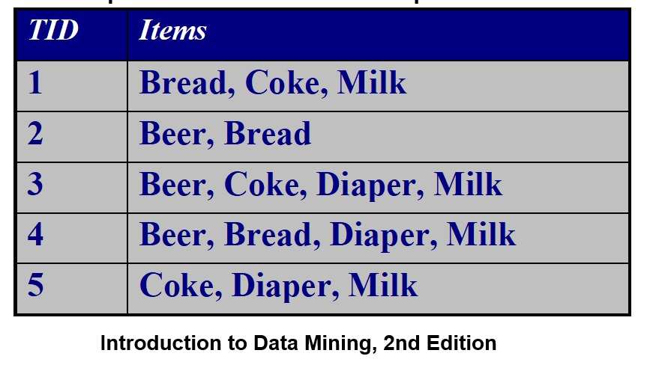
Quick Review: Examples of association rules
{Diapers} → {Beer}
{Milk, Bread} → {Coke}
{Milk, Bread} → {Coke, Diaper}
{Diapers} → {Beer, Bread}
** Association (like correlation) is a measure of co- occurrence NOT causality.

Slide 4
Measures of Set Correlation
Let X and Y be sets and assume rule X → Y
Support:
Sup(X, Y) = P(X, Y)
(Count of X and Y together) / (Total # Trans)
2) Confidence:
Conf(X, Y) = P(Y|X) = P(X,Y)/ P(X)
(Count of X and Y together) / (Count of X)

Slide 5
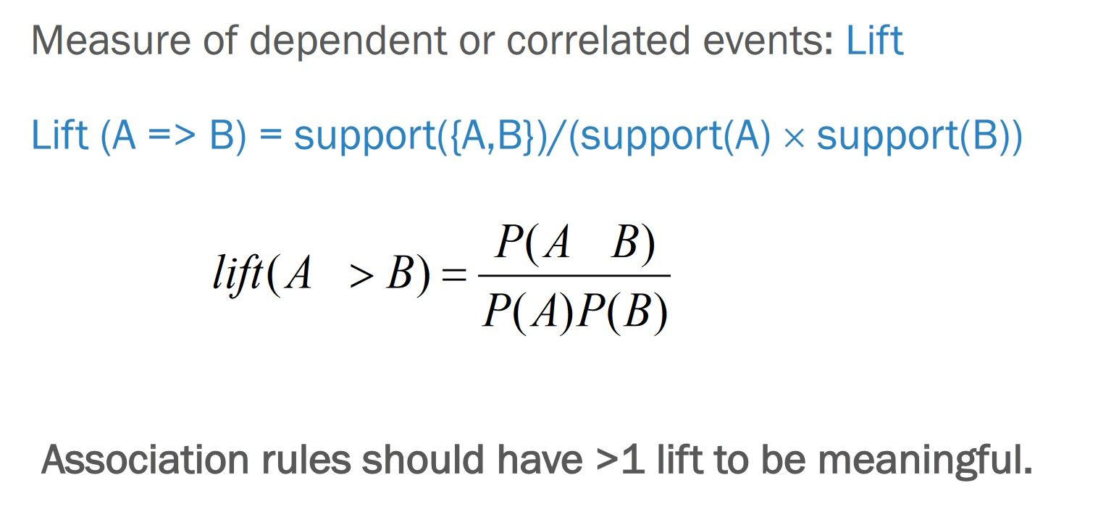
Lift

Slide 6
Quick Measure Examples
Given: {Beer }→ {Diaper}
Sup({Beer}, {Diaper}) = 2/5 = .40 = 40%
Conf({Beer}, {Diaper})
= P ( {Beer}, {Diaper}) / P({Beer})
= (2/5) / (3/5) = 66.7%
Lift ({Beer}, {Diaper}) = Sup({Beer}, {Diaper}) / Sup({Beer}) * Sup({Diaper}) = (2/5) / (3/5)*(3/5) = 1.11

Slide 7
Conceptually
X→ Y
Sup: P(X and Y) –
Measure of joint occurrence.
The more X and Y occur together, the higher the Support. Range: 0 to 1.
Conf: P(X and Y) / P(X) = P(Y|X) –
Measure of joint occurrence assuming X
As P(X) increases, conf X → Y decreases. Range: 0 to 1.
Lift: P(X and Y) / P(X)P(Y) –
= 1 when X and Y are independent.
< 1 when X and Y have little or no intersection.
> 1 when X and Y have an intersection larger than their probability product.

Slide 8
Support: P(X and Y) = low
Conf: P(X and Y)/P(X) = higher than Sup, but still low
Lift: P(X and Y)/ P(X)*P(Y) < 1
X
Y
Support: P(X and Y) = high
Conf: P(X and Y)/P(X) = high and higher than Sup
Lift: P(X and Y)/ P(X)*P(Y) > 1 Interesting
X
Y
Support: P(X and Y) = P(X) = small – based on X
Conf: P(X and Y)/P(X) = 1 (highest possible)
Lift: P(X and Y)/ P(X)*P(Y) = 1/P(Y) > 1
Interesting because X only occurs if Y
Y
X

Slide 9
X
Support: P(X and Y) = low
Conf: P(X and Y)/P(X) = higher than Sup, but still low
Lift: P(X and Y)/ P(X)*P(Y) < 1
Y
Support: P(X and Y) = 0
Conf: P(X and Y)/P(X) = 0
Lift: P(X and Y)/ P(X)*P(Y) = 0
X
Y
Support: P(X and Y) = low
Conf: P(X and Y)/P(X) = high
Lift: P(X and Y)/ P(X)*P(Y) = very high
X
Y

Slide 10
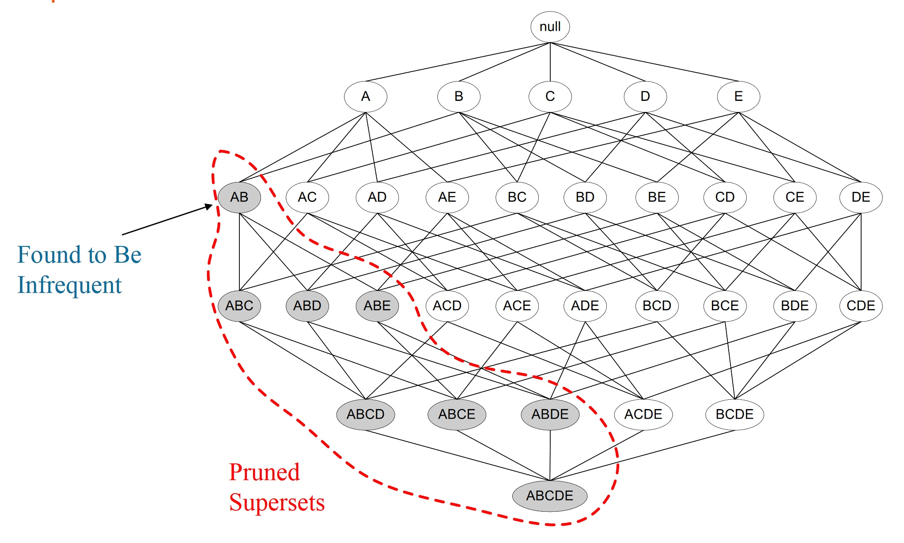
Quick Reminder: The apriori algorithm

Slide 11
Other Ways to Represent Transaction Data
1 | Bread
1 | Coke
1 | Milk
2 | Beer
2 | Bread
3 | Beer
3 | Coke
3 | Diaper
3 | Milk
4 | Beer
4 | Bread
4 | Diaper
4 | Milk
5 | Coke
5 | Diaper
5 | Milk
TID Bread Coke Milk Beer Diaper
1 1 1 1 0 0
2 1 0 0 1 0
3 0 1 1 1 1
4 1 0 1 1 1
5 0 1 1 0 1

Slide 12
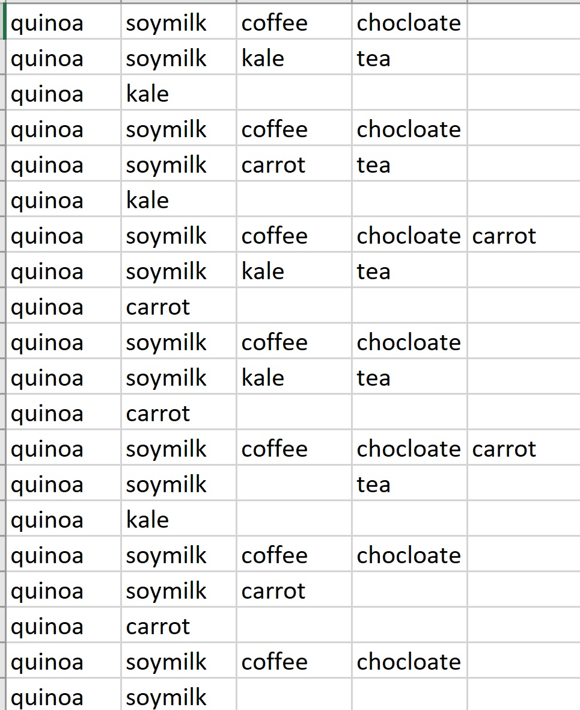
Transaction Data
Notice: It is not necessary to have a numbered transaction ID

Slide 13
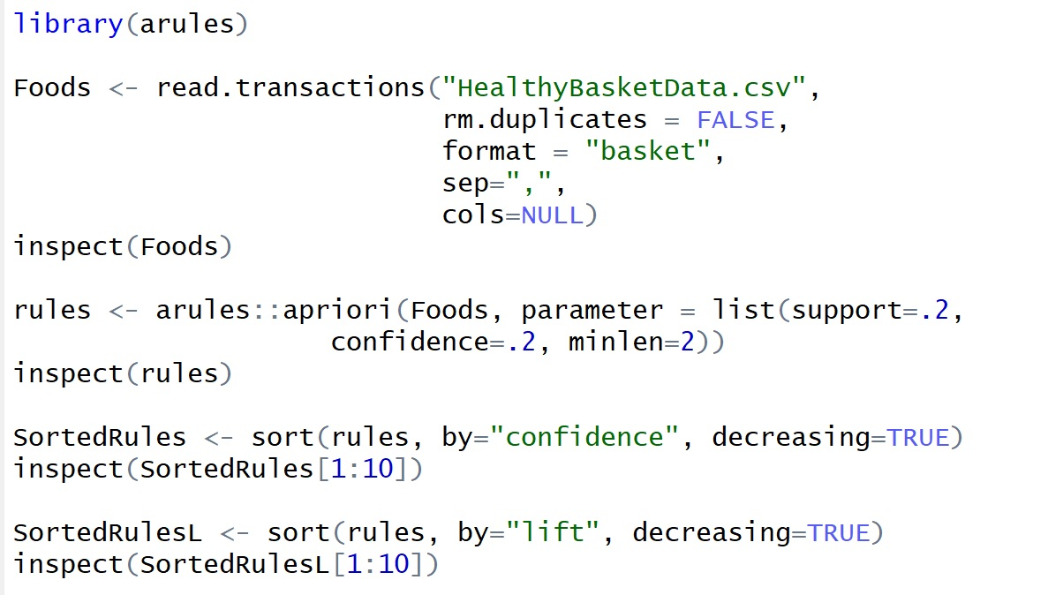
Basic ARM R Code

Slide 14
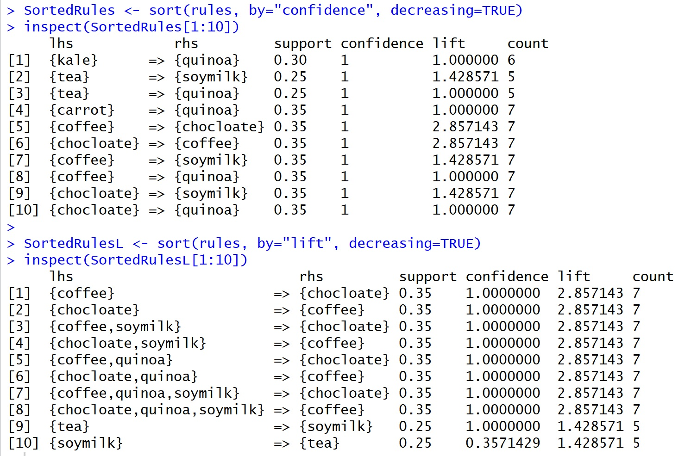

Slide 15
Read Two Common Formats
Foods <- read.transactions("KumarGroceriesTransData.csv",
rm.duplicates = FALSE,
format = "single", ##or basket
sep=",",
skip=0,
cols=c(1,2) ## for single, 1 ID col , 2 is item
## default is NULL for basket. Null means no IDs
)
arules::inspect(Foods)
Foods2 <- read.transactions("KumarGroceriesTransData_ASTRANS.csv",
rm.duplicates = FALSE,
format = "basket",
sep=",",
cols=1 ##ID in col 1 if no ID then cols=NULL
)
arules::inspect(Foods2)

Slide 16
Thinking Outside the Basket Twitter Data
Do not want a “bag of words” or a table of word frequencies.
Will need to create a “set of transactions” – one for each Tweet.
Items in the transactions will be words.

Slide 17
R Association Rules and Twitter: libraries
library(arules)
library(rtweet)
library(twitteR)
library(ROAuth)
library(jsonlite)
#library(streamR)
library(rjson)
library(tokenizers)
library(tidyverse)
library(plyr)
library(dplyr)
library(ggplot2)
#install.packages("syuzhet")
## sentiment analysis
library(syuzhet)
library(stringr)
library(arulesViz) ## load last
## Trouble with arulesViz?
## FIRST - you MUST register and log into github
## install_github("mhahsler/arulesViz")
## RE: https://github.com/mhahsler/arulesViz

Slide 18
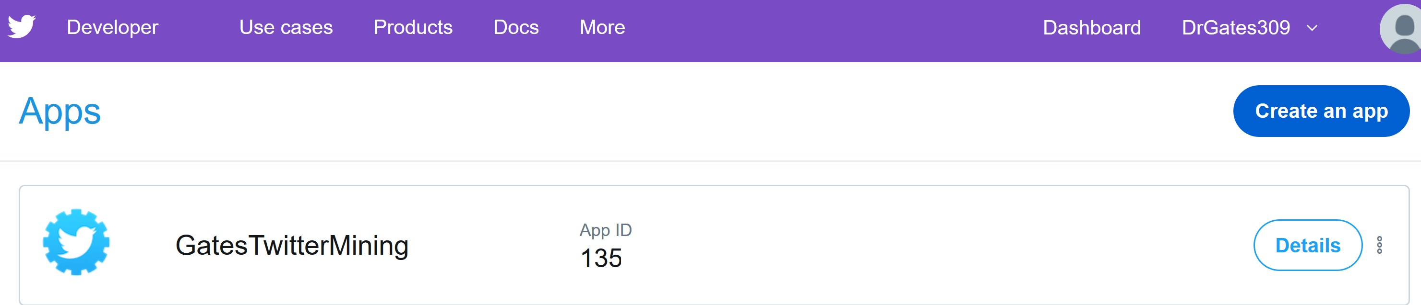
Set Up Twitter Dev Account First
https://developer.twitter.com/

Slide 19
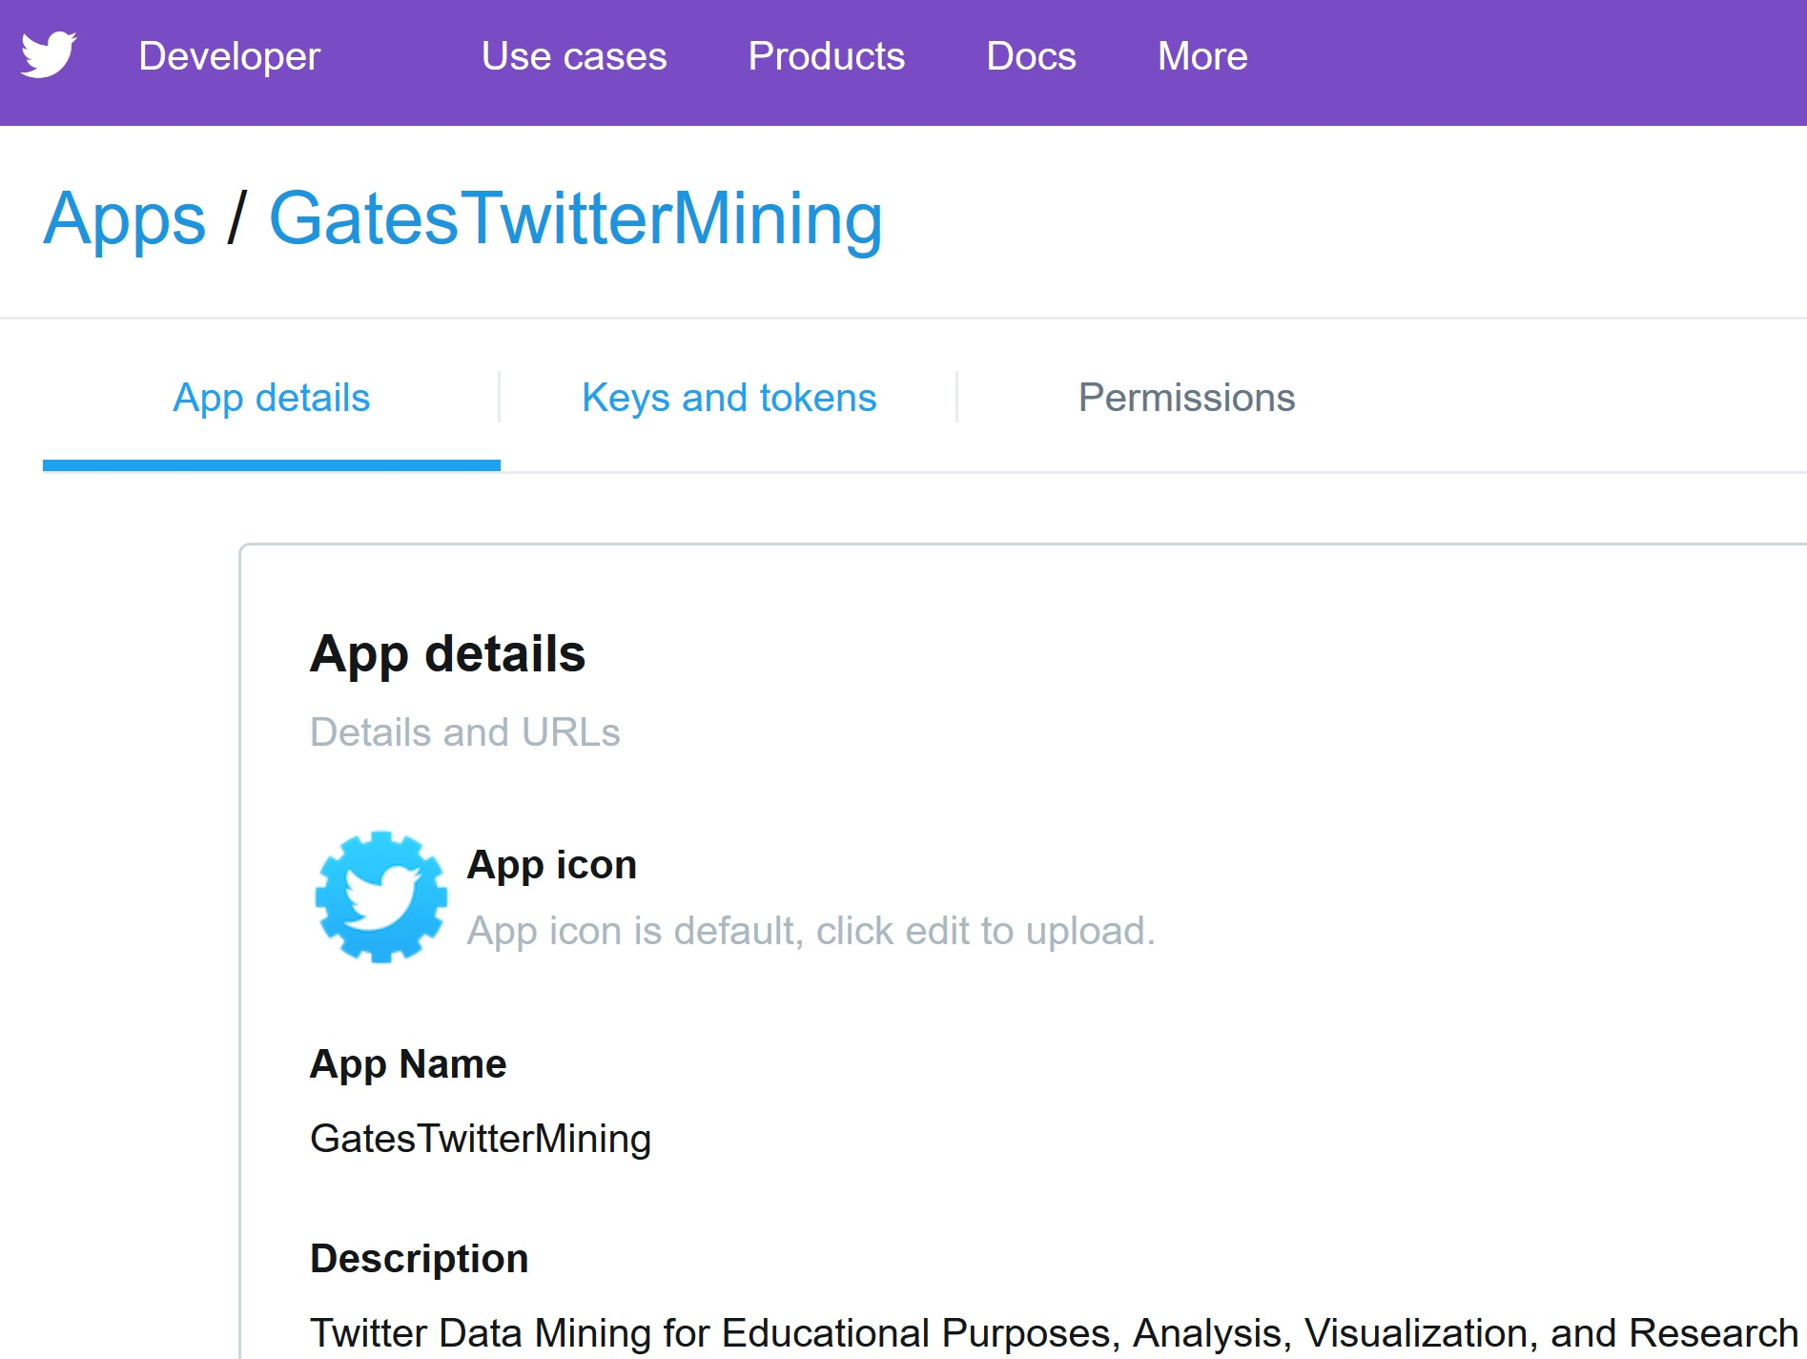
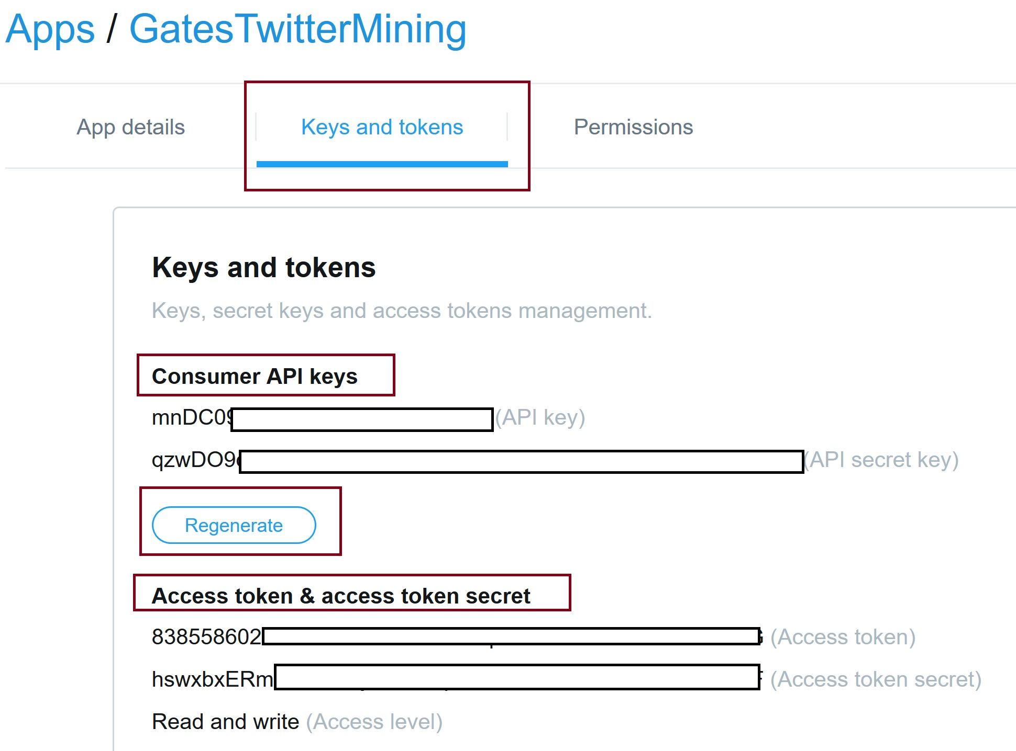

Slide 20
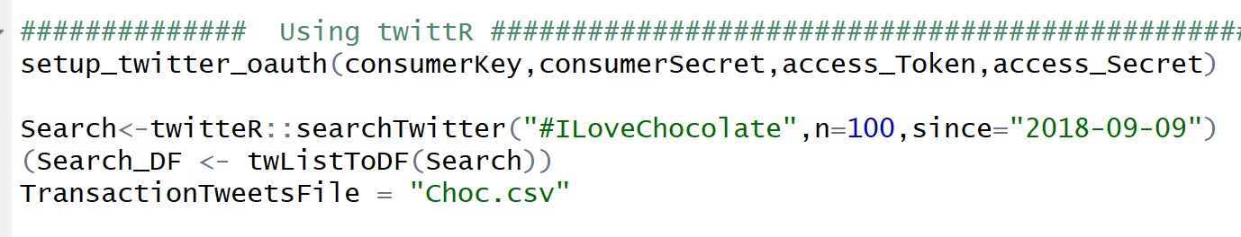
R Twitter Options

Slide 21
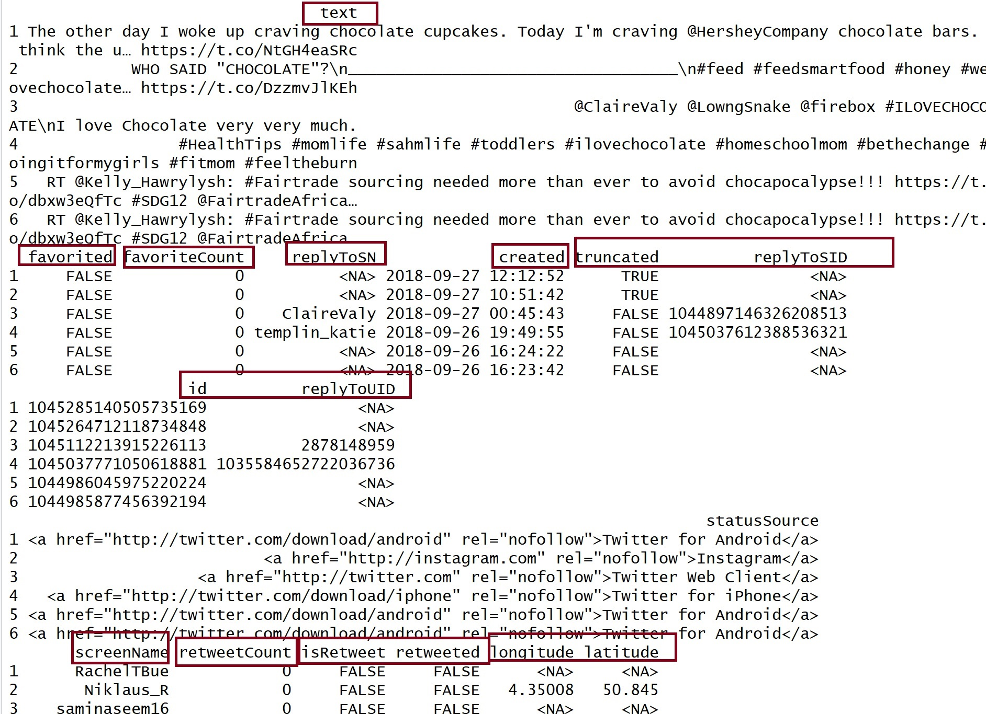

Slide 22
Build the Transaction File: Step 1
Each tweet should be one transaction.
Each word (token) in the tweet should be in its own column.

Slide 23
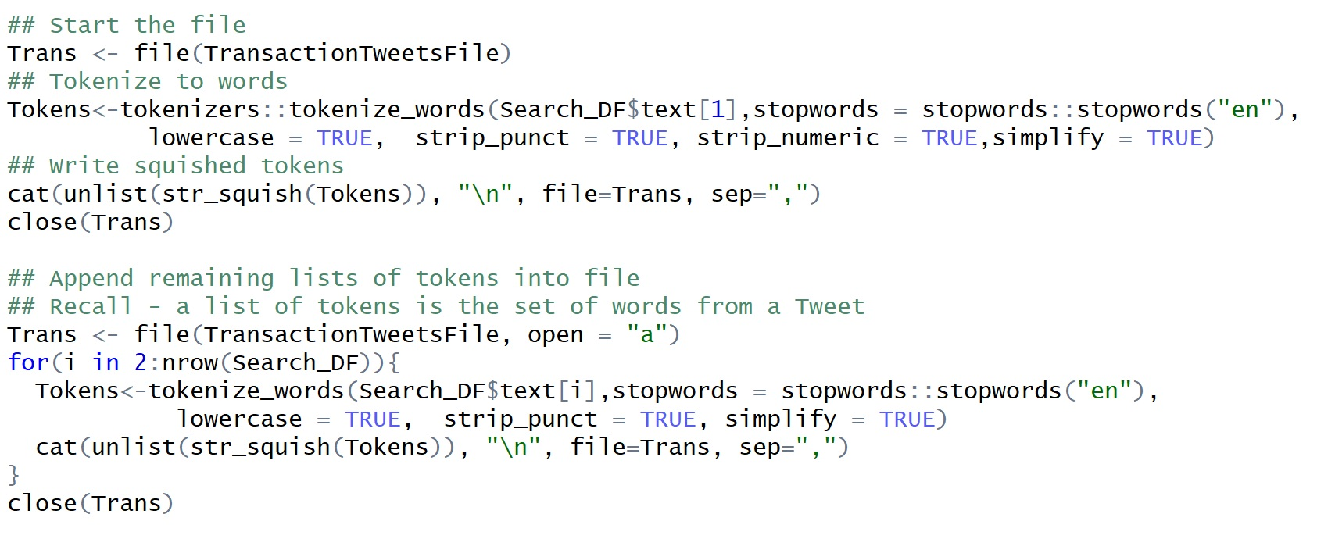
Build The Transaction File: Step 2

Slide 24
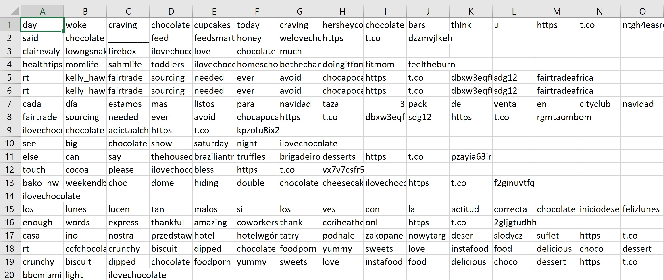
Transaction File: Each Row is a Tweet

Slide 25
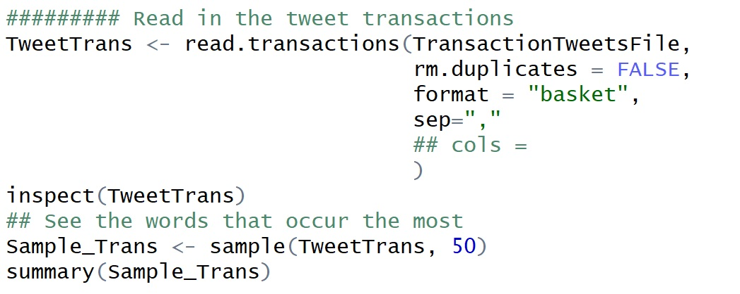
Read and Inspect the Transactions

Slide 26
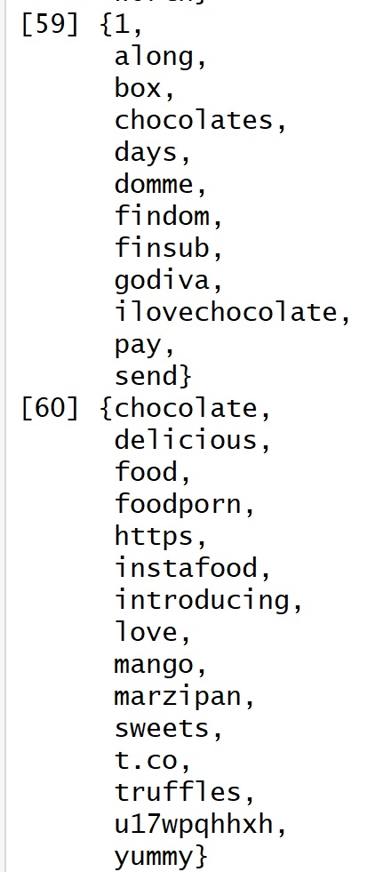
Transaction Sets and Summary

Slide 27
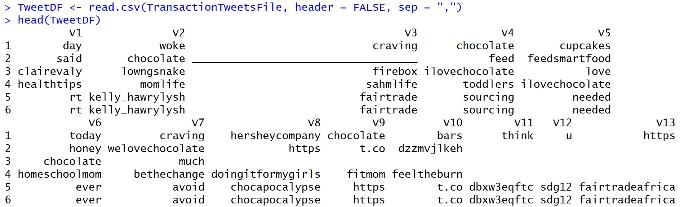
Clean Up

Slide 28
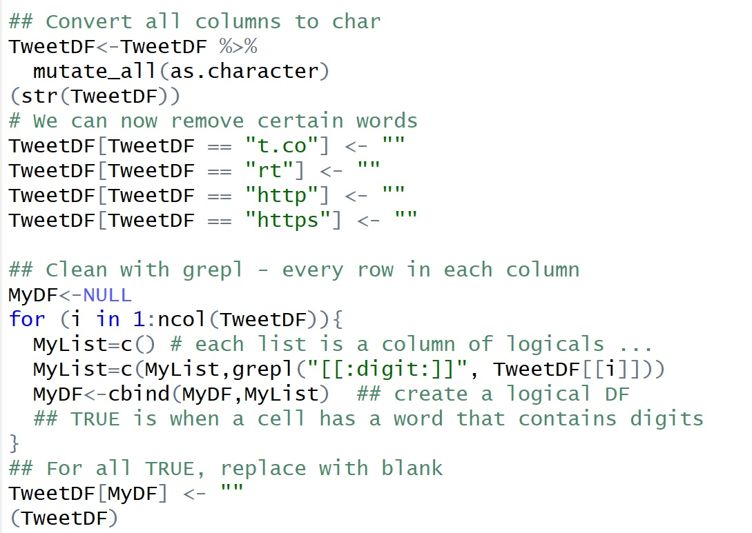
Specifically Remove Words

Slide 29
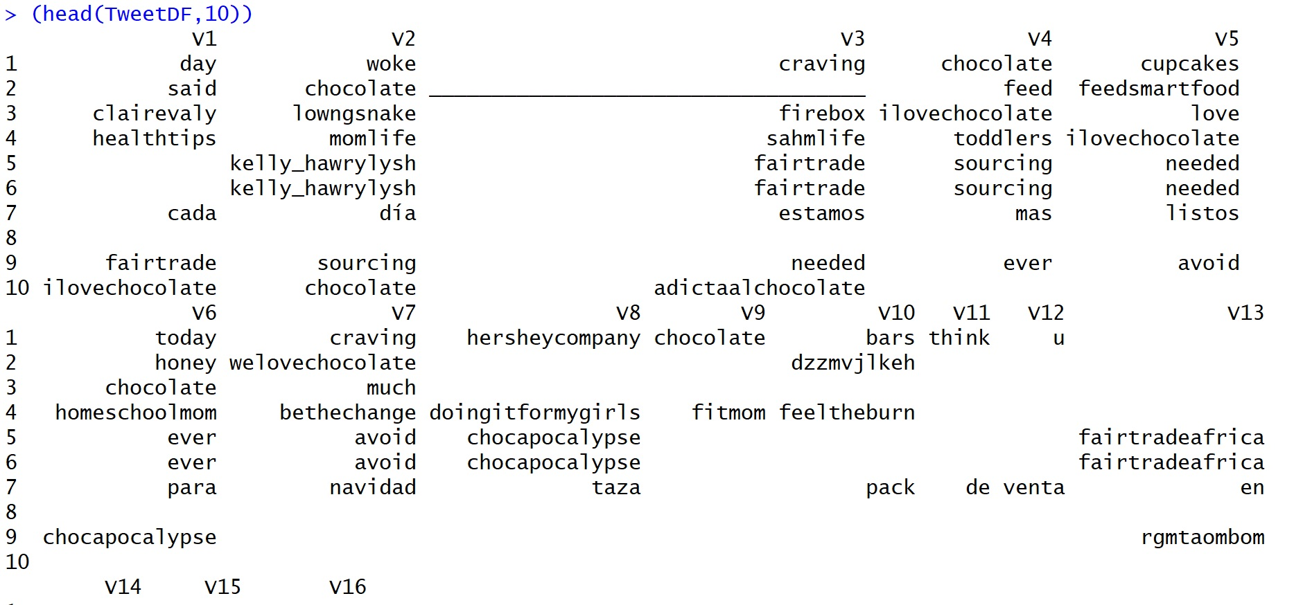
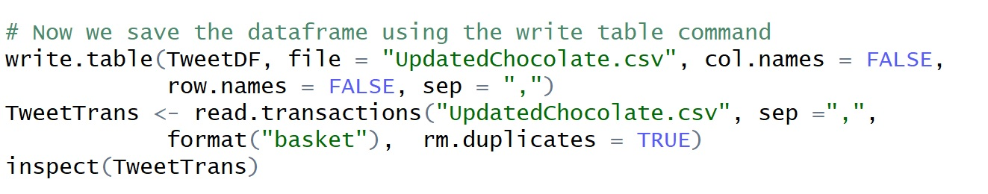
Our Transactions

Slide 30
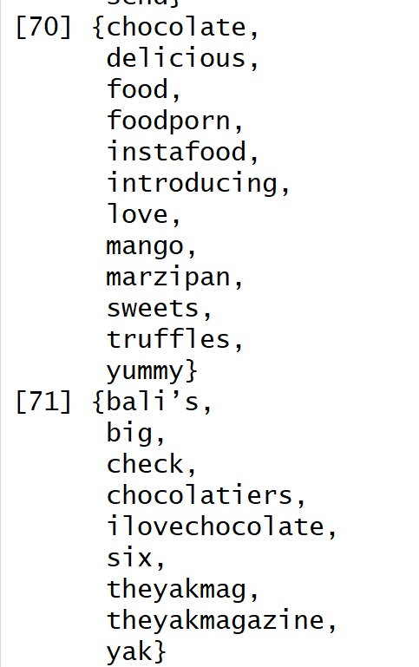
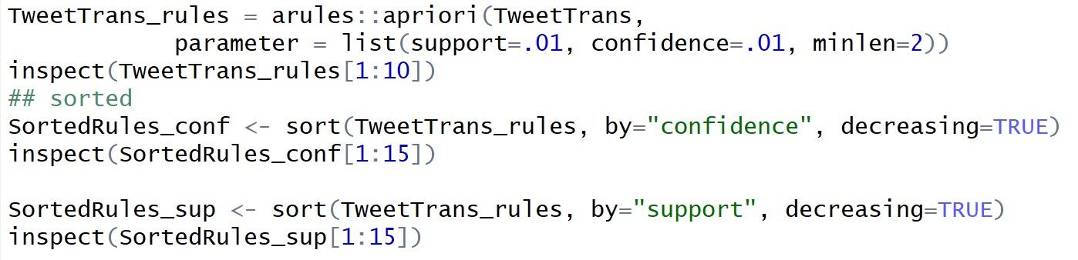
Association Rule Mining
Example cleaned tweets as individual transactions.

Slide 31
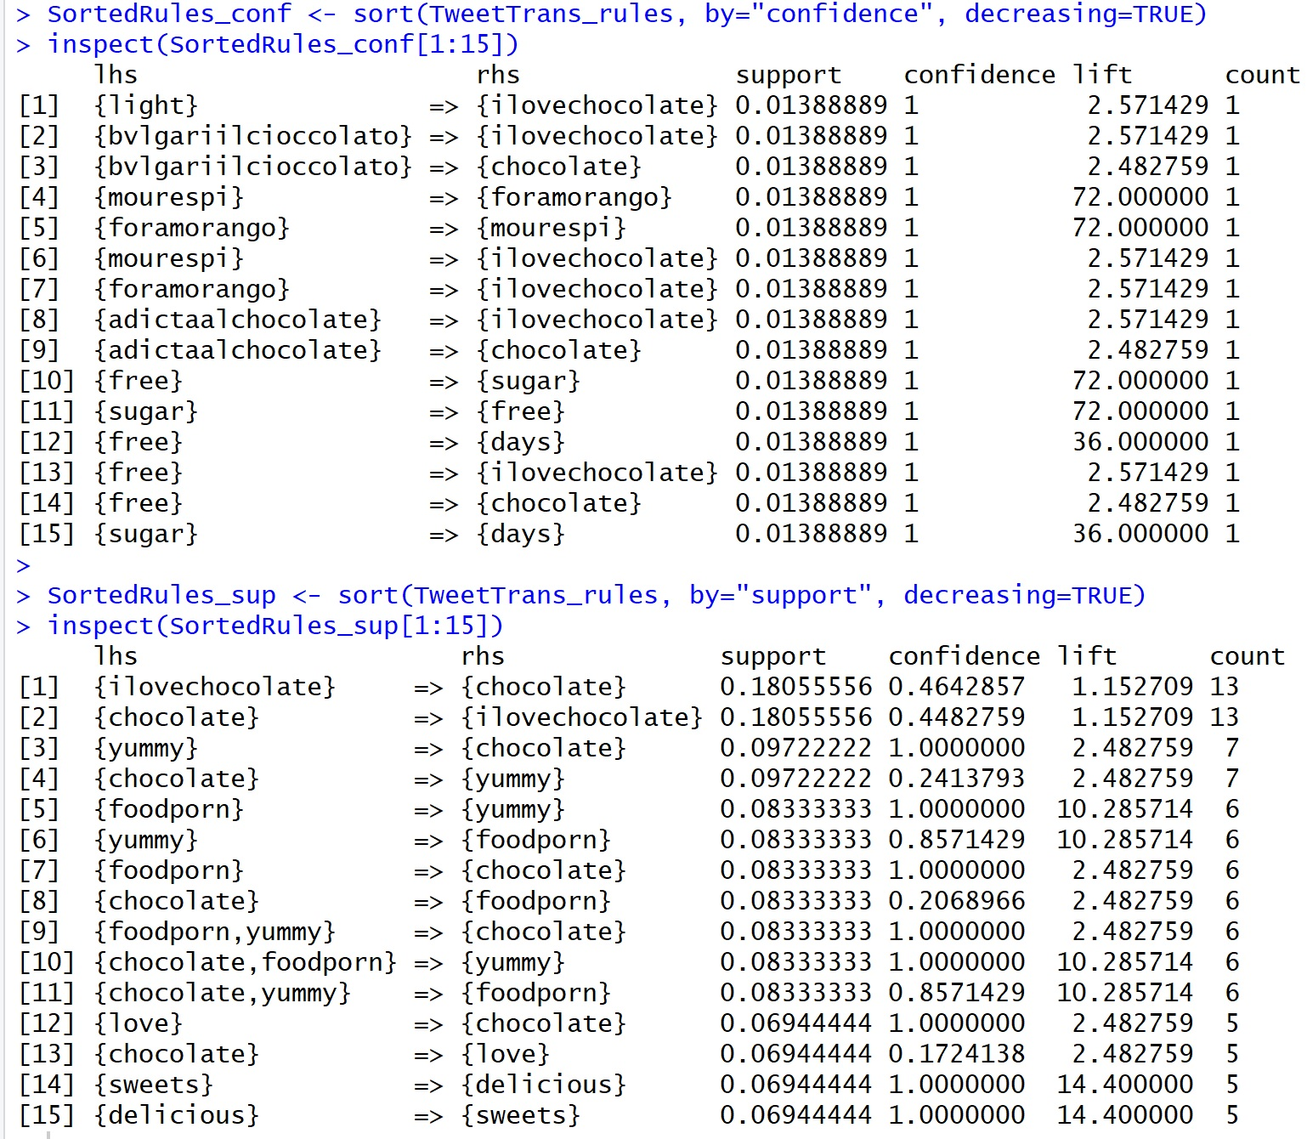

Slide 32
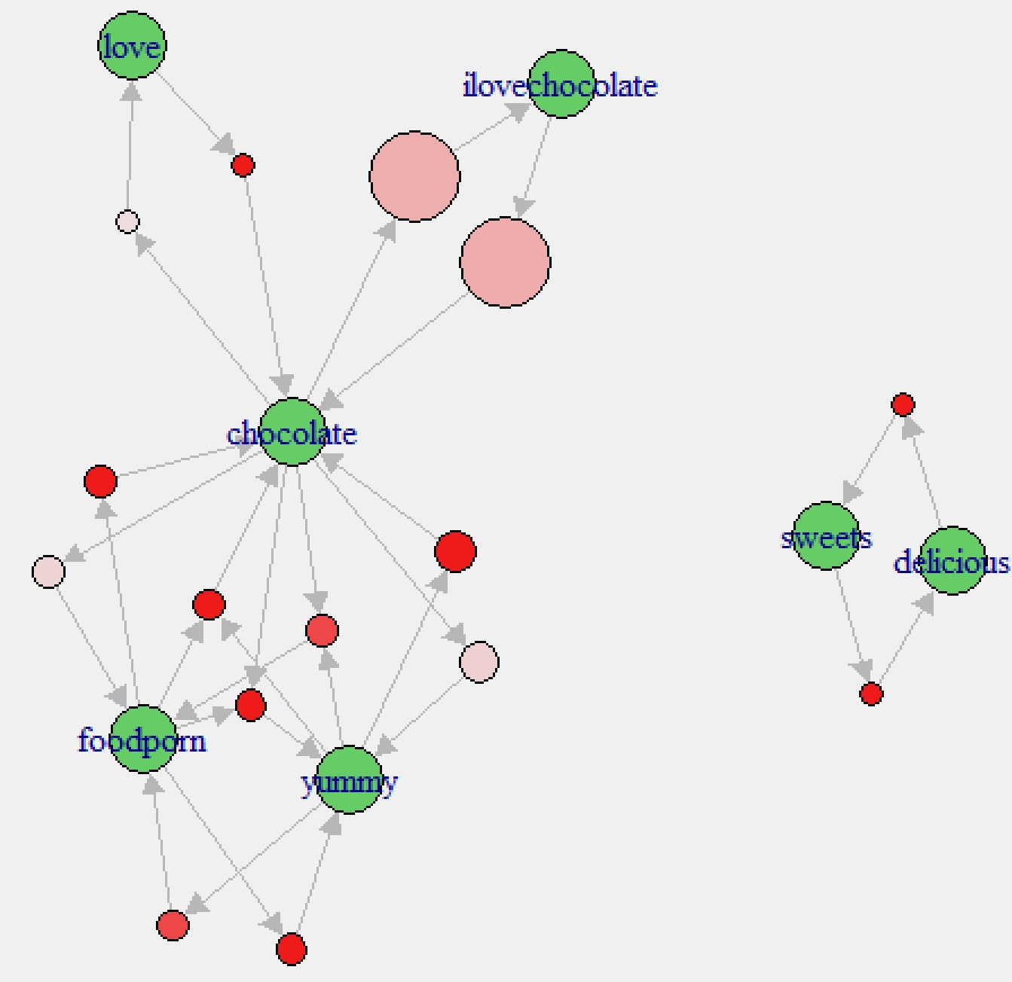
A Quick Plot

Slide 33
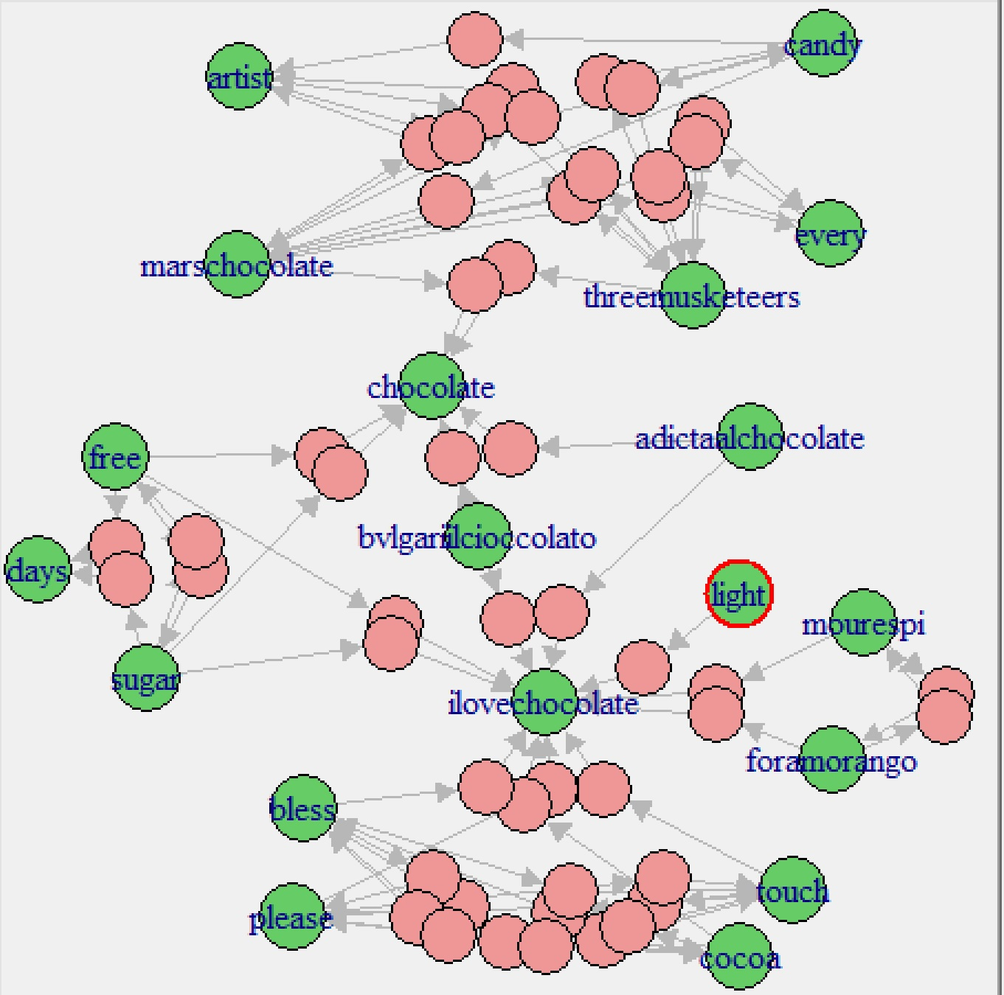
Looking at More Rules

